Slide 1

STUDENT CAREER PLACEMENT PREDICTOR
Name: Harshitha T N, Dhanya R and Ananya P C.
College: Harsha Institute Of Management Studies
Department: Department of Computer Science
Degree: BCA VI semester
Batch: 2023-26

Slide 2
Problem Statement
Nearly 40% of Indian Graduates aged 22-25 are unemployed (Azim Premji University, 2026).
Only 42.6% of Indian Graduates were employable in 2024 due to skill gaps (Mercer-Mettl, 2025).
Only 8.25% of graduates work in roles matching their qualifications (Economic Survey 2024-25).
Students lack personalized career guidance.
Traditional placement processes are manual, slow and inefficient.

Slide 3
Objectives
Predict the best-fit career for a student based on academics and skills.
Provide AI-generated personalized career roadmap.
Helps recruiters filter the right candidates effectively.
Reduces skill-employment mismatch among fresh graduates.
Make career guidance accessible to every student digitally.
“Key reasons behind the problem”

Slide 4
Technologies Used
Frontend:
HTML, CSS, JavaScript
Light/Dark mode toggle
Keyboard shortcuts for accessibility
Backend:
Python
Flask framework
REST API architecture
Database:
MySQL – stores student, recruiter and admin data
Machine Learning:
Random Forest Classifier
Trained on academic and skill-based features
AI Integration:
Gemini AI – generates personalized career roadmaps
Additional Features:
PDF report generation
Three–role system – Student, Recruiter, Admin

Slide 5
How It Works
Student Login
Enter Academic & Skill Details
Random Forest ML Model
Career Prediction
Gemini AI Roadmap
PDF Report Download

Slide 6
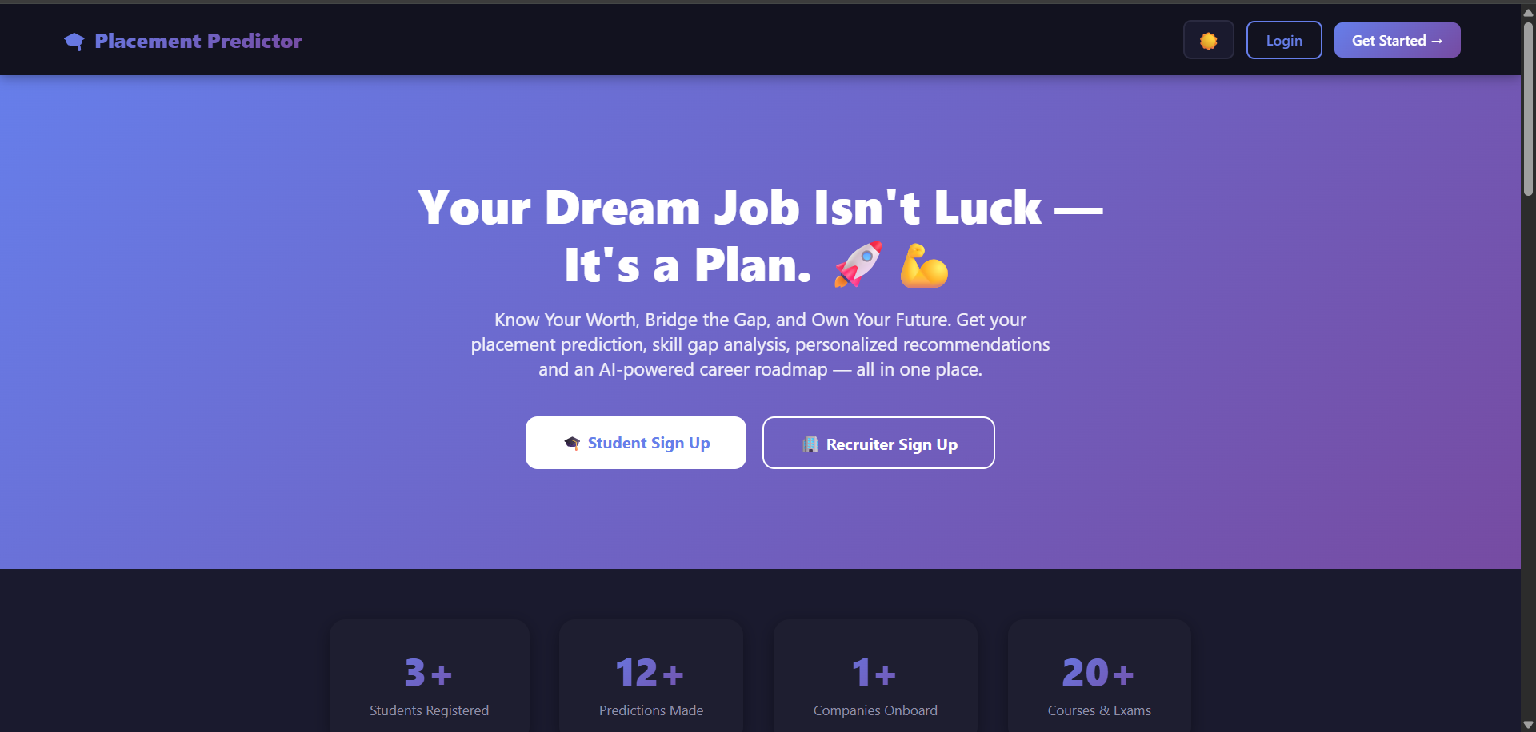
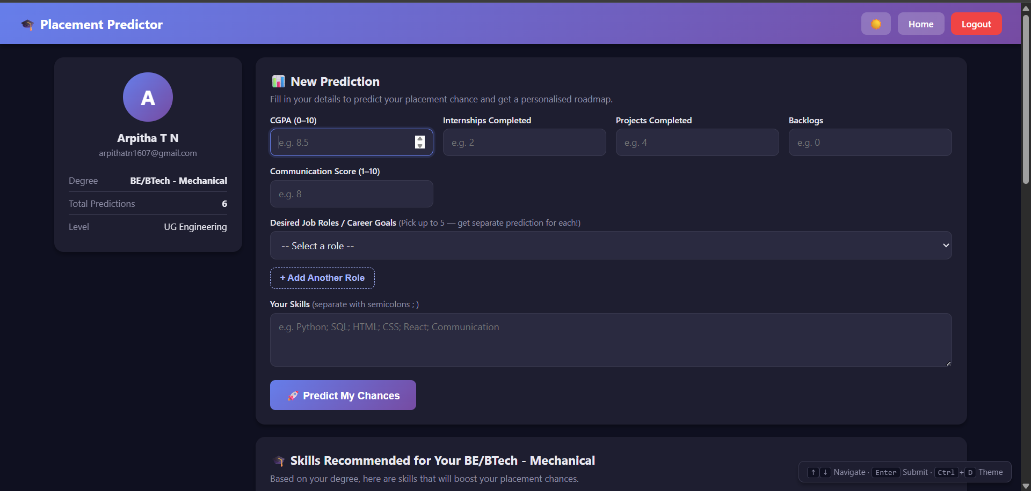
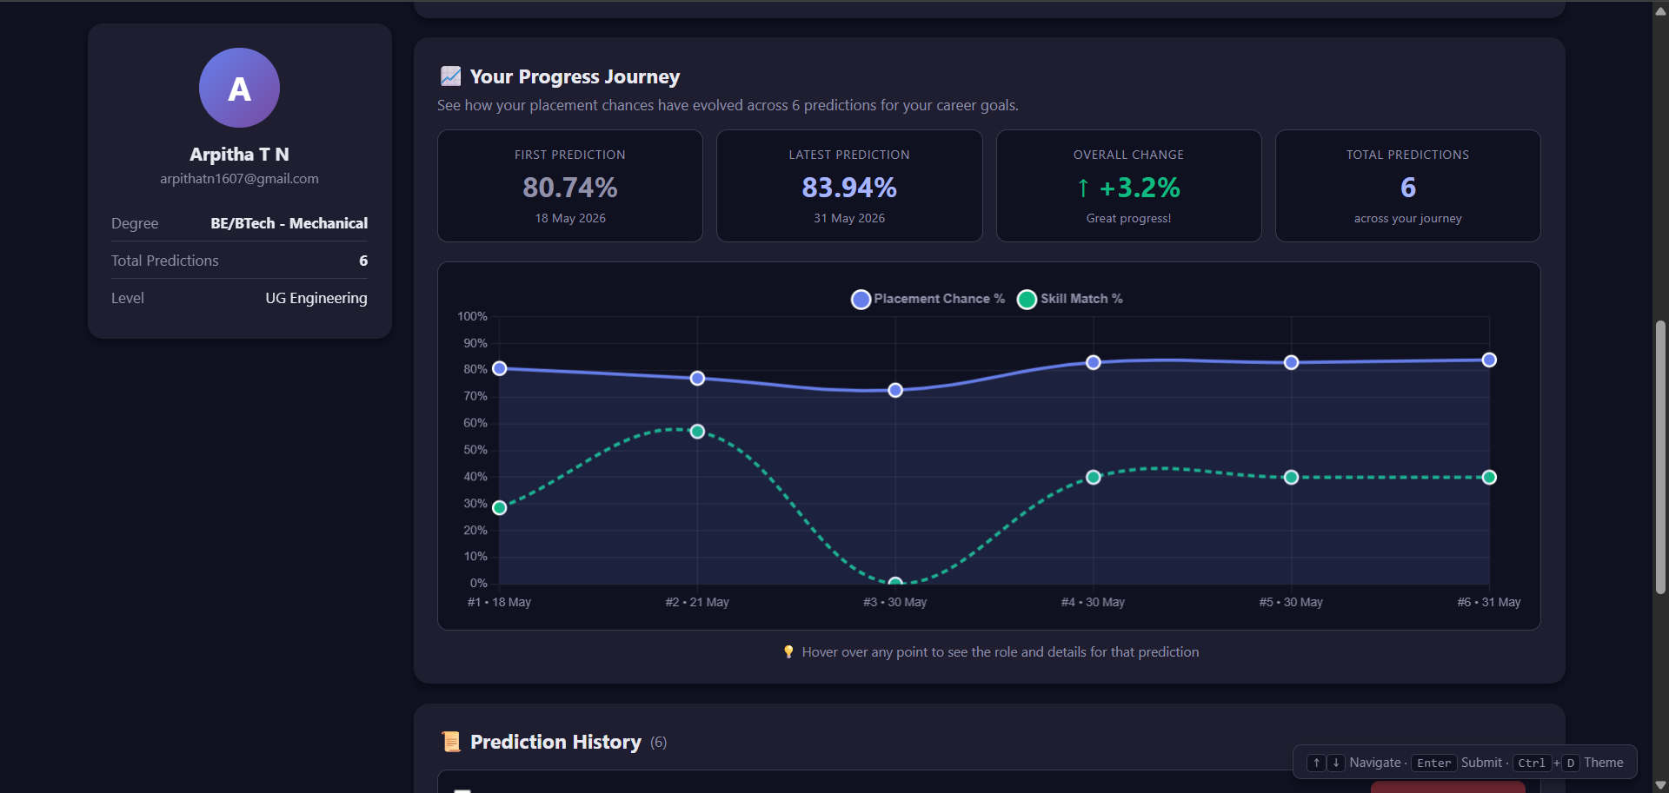
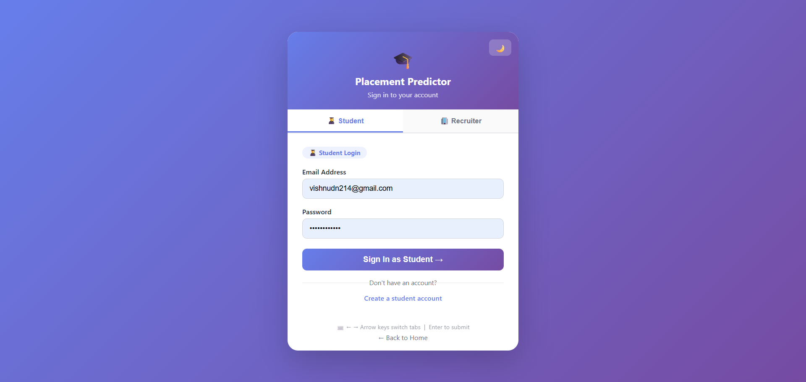

Slide 7
Applications
Students can get personalized career predictions based on academics and skills.
Provides AI-generated step-by-step career roadmap for each student.
Recruiters can filter and shortlist the right candidates effectively.
Colleges can use it as a placement readiness tool before final year.
Career counselors can use it as a data-backed guidance tool.
Helps identify skill gaps at institutional level.
Government and NGOs can use aggregate data to design targeted training programs.
Makes career guidance digitally accessible to students in rural and urban areas.

Slide 8
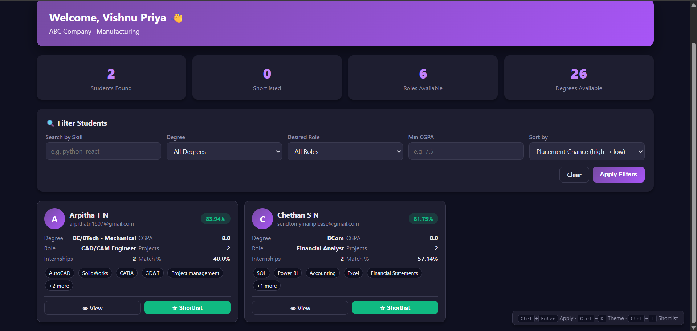
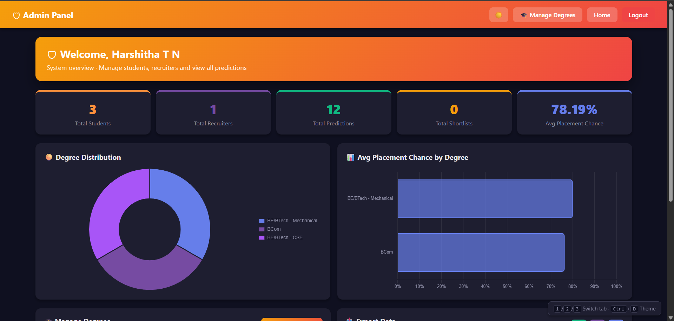

Slide 9
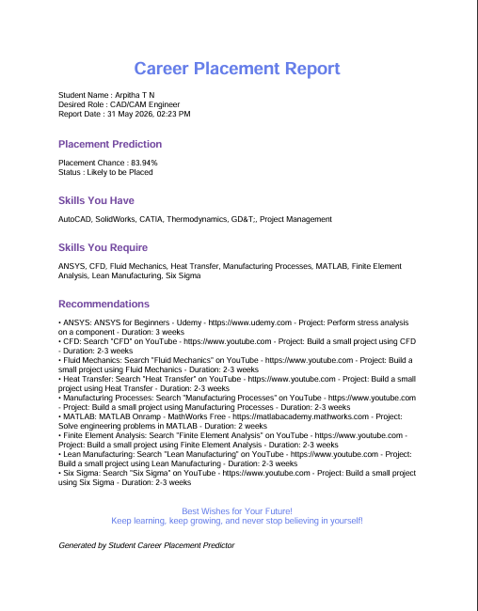

Slide 10
Limitations
Model accuracy depends on quality and size of training data.
Does not consider soft skills, attitude or interview performance.
Gemini AI roadmaps may not reflect local job market conditions.
No real-time integration with job portals like LinkedIn or Naukri.
Predictions may be biased if training data lacks diversity.
Currently supports only predefined career categories.
System requires stable internet connection for AI roadmap generation
Limited to academic and skill-based inputs only

Slide 11
CONCLUSION
Successfully built an ML-based web application to predict student career paths.
Random Forest Classifier provides accurate career prediction based on academics and skills.
Gemini AI generates personalized roadmaps bridging the skill-employment gap
Three-role system ensures smooth interaction between students, recruiters and admin.
Addresses the growing problem of graduate unemployment in India.
Makes career guidance accessible, digital and personalized for every student.
Future scope – real time job portal integration and expanded career categories.
“This project is a step towards making every student’s career journey smarter and more guided.”

